Slide 1
Introduction of Work:-
MySql and Colorama has been used mostly, other than these we used datatime, random and os module.
We have created a colourful command line Online banking system. One can use this to implement as a real bank, we can create account, deposit, withdraw, check balance etc.

Slide 2
Motivation of Work:-
We are in 2023 but still Banking system still uses that black and white interface with some faded background colors, so we decided to change this and bring some colors in their life.
Main Reason: We decided to choose this because it was challenging for us to learn SQL and implement our knowledge in Python. We also didn’t find any other project where we can learn something new so we decided to work on this project.
MONEY AND KNOWLEDGE ATTRACTS EVERYONE

Slide 3
System Requirements:-
Python : 3.8 or higher version
Colorama : 0.4.6 (latest)
MySql : 8.0.32.0
Mysql-connector : 8.0.32

Slide 4
PROPOSED WORK
Asking user to login, signup
Initiating Database
Asking new User about his’s or her’s details
Updating data of the user in the database
Giving choice to user to deposit, withdraw money
Saving those details in database

Slide 5
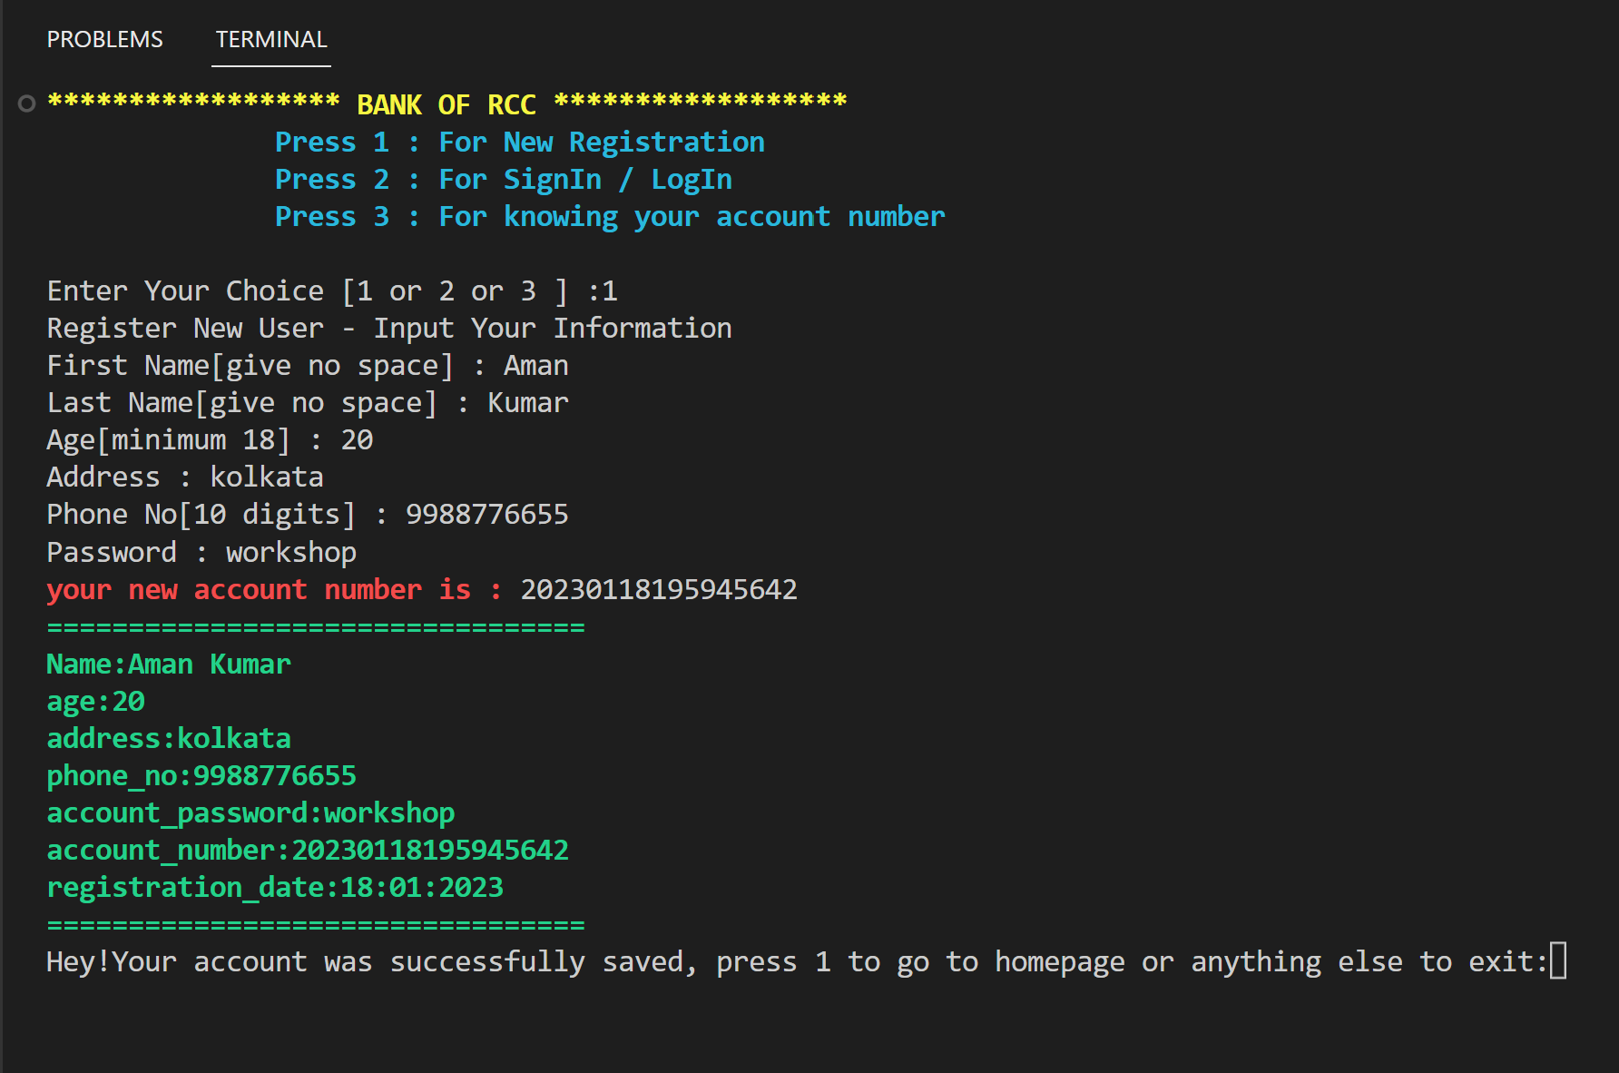
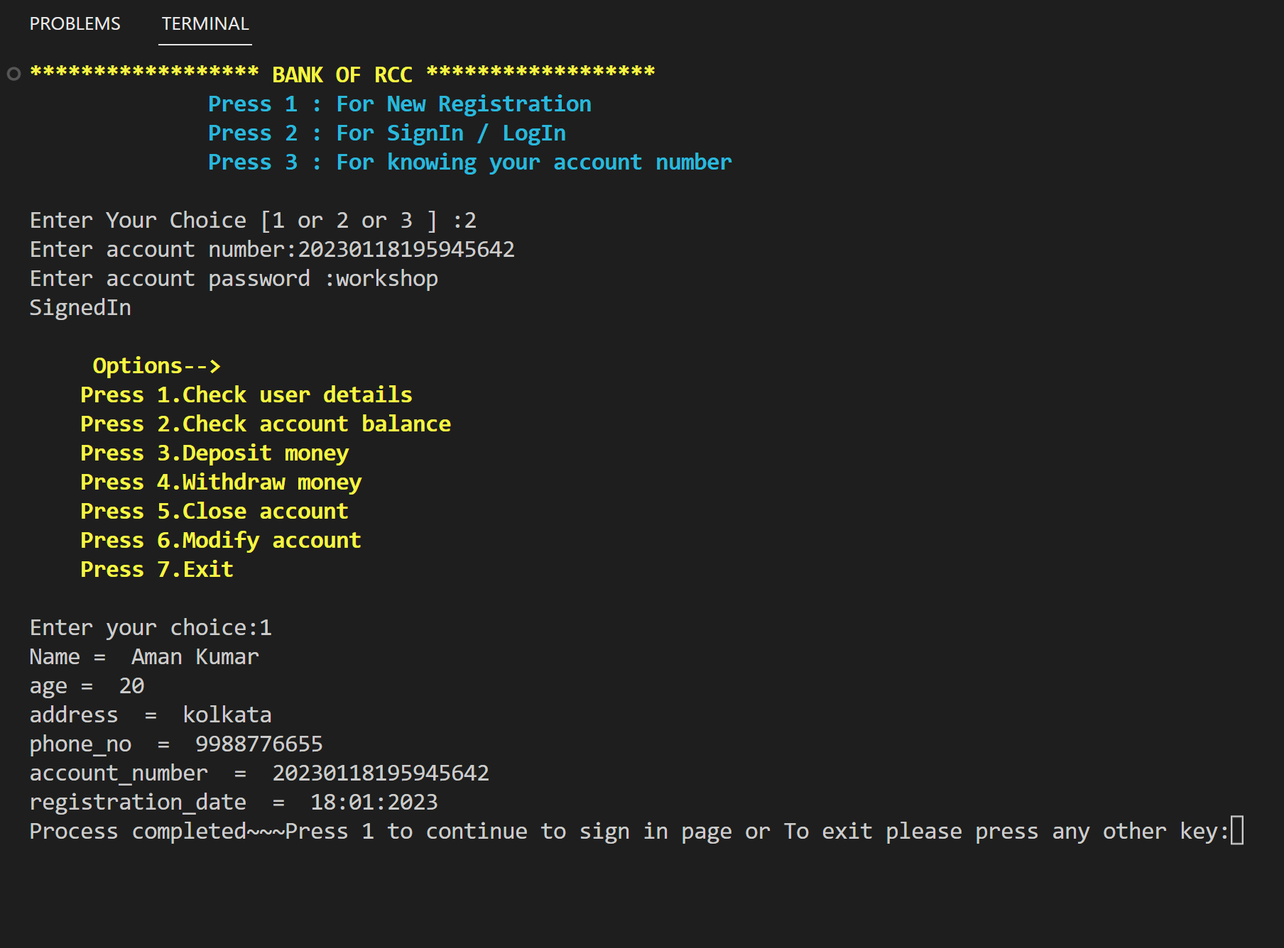
OUTPUT
REGISTRATION
User’s Details

Slide 6
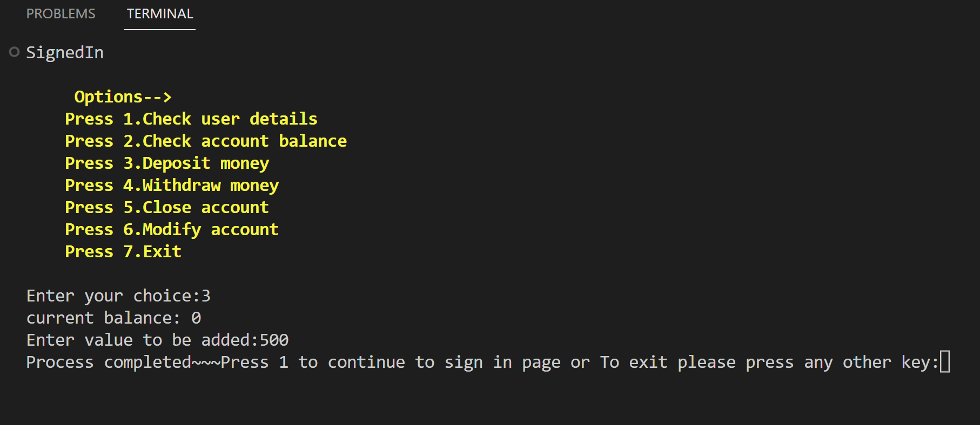
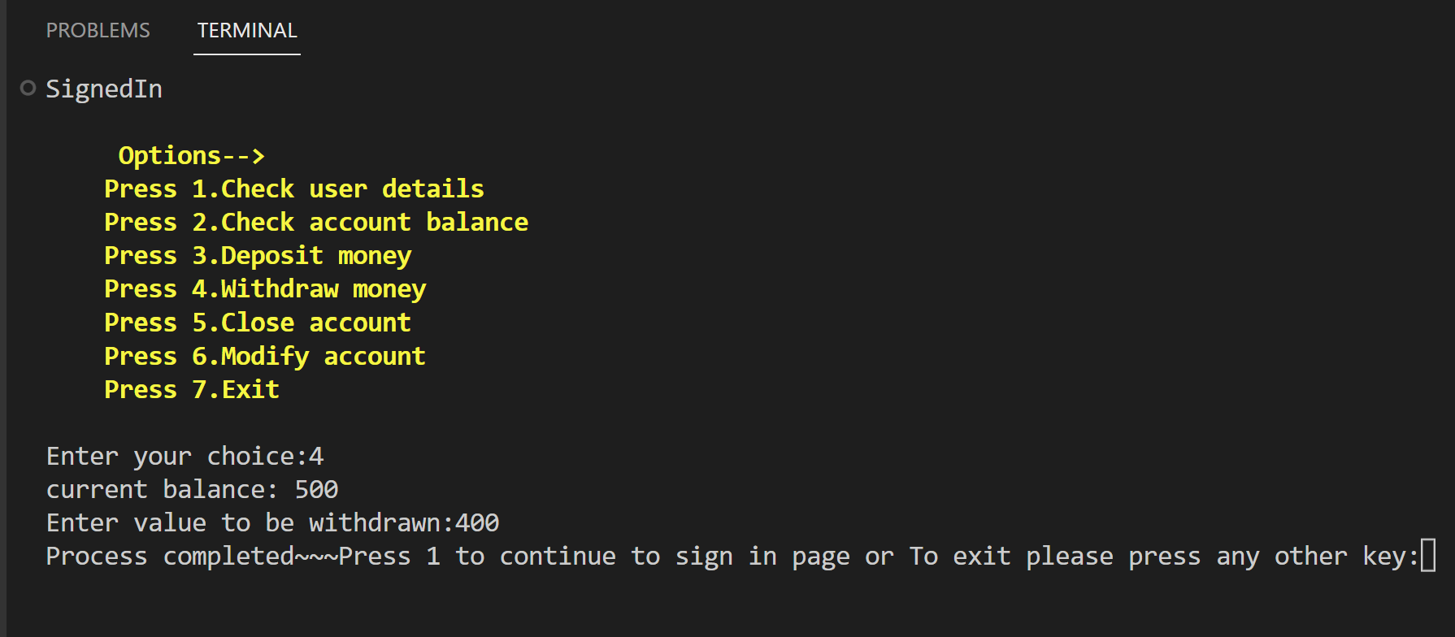
DEPOSIT
WITHDRAW

Slide 7
CODE
import colorama
import datetime as datetime
import random as random
import mysql.connector
import os
from colorama import Fore, Style
colorama.init(autoreset=True)
def attain_server_pass():
global server_pass
server_pass = input("Please enter mysql server pass :")
cls()
def cls():
os.system('cls' if os.name == 'nt' else 'clear')
def establish_database():
global server_pass
mydb = mysql.connector.connect(
host="localhost",
user="root",
password=f"{server_pass}",
)
#creating database
sql_select_query = "create database if not exists RCCBanking;" \
"use RCCBanking;" \
"create table userData( name varchar(100),age varchar(100),address varchar(100),phone_no " \
"varchar(100),account_password varchar(100),account_number varchar(100) ,registration_date " \
"varchar(100), account_bal varchar(100)); "
cursor = mydb.cursor()
cursor.execute(sql_select_query, multi=True)
def homeScreen():
print("Home Screen")
def saveToDataBase(name, age, address,phone_no, account_password, account_number,
registration_date):
global server_pass
mydb = mysql.connector.connect(
host="localhost",
user="root",
password=f"{server_pass}",
database="RCCBanking",
)
#printing all required variables
print(f"{Fore.GREEN}{Style.BRIGHT}=================================")
print(f"{Fore.GREEN}{Style.BRIGHT}Name:{name}")
print(f"{Fore.GREEN}{Style.BRIGHT}age:{age}")
print(f"{Fore.GREEN}{Style.BRIGHT}address:{address}")
print(f"{Fore.GREEN}{Style.BRIGHT}phone_no:{phone_no}")
print(f"{Fore.GREEN}{Style.BRIGHT}account_password:{account_password}")
print(f"{Fore.GREEN}{Style.BRIGHT}account_number:{account_number}")
print(f"{Fore.GREEN}{Style.BRIGHT}registration_date:{registration_date}")
print(f"{Fore.GREEN}{Style.BRIGHT}=================================")
# Saving Data to Database
myCursor = mydb.cursor()
sql = f"INSERT INTO userData (name, age, address, phone_no, " \
"account_password, account_number, registration_date, account_bal) " \
f"VALUES ('{name}', {age}, '{address}', {phone_no}," \
f"'{account_password}', {account_number}, '{registration_date}', 0 )"
myCursor.execute(sql)
mydb.commit()
def createUniqueAccountNo():
now = datetime.datetime.now()
part1 = now.strftime("%Y%m%d%H%M%S")
a = now.strftime("%d:%m:%Y")
part2 = str(random.randint(111, 999))
account_number = part1 + part2
print(f"{Fore.RED}{Style.BRIGHT}your new account number is :", account_number)
return account_number, a
def input_warning():
a = input("Please enter data Correctly \n, press 1 to retry or anything else to exit:")
if a == "1":
cls()
registerNewUser()
else:
print("\t Byee :( \n")
exit()
def registerNewUser():
print("Register New User - Input Your Information")
First_name = input("First Name[give no space] : ").strip()
if First_name.isalpha() is False:
input_warning()
else:
pass
Last_name = input("Last Name[give no space] : ").strip()
if Last_name.isalpha() is False:
input_warning()
else:
pass
name = First_name + " " + Last_name
age = input("Age[minimum 18] : ").strip()
if (age.isdigit() is True) and (18 <= int(age)) and (int(age) <= 120):
pass
else:
input_warning()
address = input("Address : ").strip()
phone_no = input("Phone No[10 digits] : ").strip()
if (phone_no.isdigit() is True) and (len(phone_no) == 10):
pass
else:
input_warning()
if phone_no in get_phone():
print("Already user registered on this number")
input_warning()
else:
pass
account_password = input("Password : ").strip()
account_number, registration_date = createUniqueAccountNo()
saveToDataBase(name, age, address,
phone_no, account_password, account_number,
registration_date)
x = input("Hey!Your account was successfully saved, press 1 to go to homepage or anything else to exit:")
if x == "1":
cls()
start_Program()
else:
exit()
def user_authentication():
global user_chk
global server_pass
user_chk = int(input("Enter account number:"))
# print(user_chk)
connection = mysql.connector.connect(host='localhost', database='RCCBanking',user='root',
password=f'{server_pass}')
sql_select_query = f"select account_password from userData where account_number = {user_chk}"
cursor = connection.cursor()
cursor.execute(sql_select_query)
# Fetching all records
records = cursor.fetchall()
ck = records[0]
chk = ck[0]
user_pass = input("Enter account password :")
if chk == user_pass:
signIn()
else:
print("wrong id or pass")
user_authentication()
return user_chk
def get_account_no():
global user_chk
global server_pass
mydb = mysql.connector.connect(host="localhost",user="root",password=f"{server_pass}",database="RCCBanking”
phone = input("Enter phone no. registered to account: ")
sql_select_query = f"select account_number from userData where phone_no = {phone} "
cursor = mydb.cursor()
cursor.execute(sql_select_query)
y = cursor.fetchall()
print(y[0][0])
def get_phone():
global user_chk
global server_pass
mydb = mysql.connector.connect(
host="localhost",
user="root",
password=f"{server_pass}",
database="RCCBanking",
)
sql_select_query = f"select phone_no from userData; "
cursor = mydb.cursor()
cursor.execute(sql_select_query)
y = cursor.fetchall()
phone_nos = []
for i in y:
for j in i:
phone_nos.append(j)
return phone_nos
def modify_acc():
global user_chk
global server_pass
print('''Modify your account:-
please renter your details: ''')
mydb = mysql.connector.connect(
host="localhost",
user="root",
password=f"{server_pass}",
database="RCCBanking",
)
name = input("Name : ")
age = input("Age : ")
address = input("Address : ")
phone_no = input("Phone No : ")
sql_select_query = f"update userdata set name = '{name}', age = '{age}', address = '{address}', " \
f"phone_no = '{phone_no}'" \
f"where account_number = {user_chk}; "
cursor = mydb.cursor()
cursor.execute(sql_select_query)
mydb.commit()
def withdraw_money():
global user_chk
global server_pass
mydb=mysql.connector.connect(host="localhost",user="root",password=f"{server_pass}",database="RCCBanking“,)
sql_select_query = f"select account_bal from userData where account_number = {user_chk} "
cursor = mydb.cursor()
cursor.execute(sql_select_query)

Slide 8
CODE
y = cursor.fetchall()
x = y[0]
balance = int(x[0])
print("current balance:", balance)
get = int(input("Enter value to be withdrawn:"))
total = balance - get
if total >= 0:
sql_select_query2 = f"update userData set account_bal = {total} where account_number = {user_chk}"
cursor.execute(sql_select_query2)
mydb.commit()
else:
print("Not enough balance")
def deposit_money():
global user_chk
global server_pass
mydb = mysql.connector.connect(host="localhost",user="root",
password=f"{server_pass}",database="RCCBanking",)
sql_select_query = f"select account_bal from userData where account_number = {user_chk} "
cursor = mydb.cursor()
cursor.execute(sql_select_query)
y = cursor.fetchall()
x = y[0]
balance = int(x[0])
print("current balance:", balance)
add = int(input("Enter value to be added:"))
total = balance + add
sql_select_query2 = f"update userData set account_bal = {total} where account_number = {user_chk}"
cursor.execute(sql_select_query2)
mydb.commit()
def delete_account():
global user_chk
global server_pass
mydb = mysql.connector.connect(host="localhost",user="root",password=f"{server_pass}",database="RCCBanking",)
sql_select_query = f"delete from userData where account_number = {user_chk} "
cursor = mydb.cursor()
cursor.execute(sql_select_query)
mydb.commit()
x = input("Your account has been successfully closed, press enter to leave")
x.strip()
exit()
def chk_acc_bal():
global user_chk
global server_pass
# print(user_chk)
connection = mysql.connector.connect(host='localhost',database='RCCBanking',user='root',password=f'{server_pass}') sql_select_query = f"select account_bal from userData where account_number = {user_chk}"
cursor = connection.cursor()
cursor.execute(sql_select_query)
records = cursor.fetchall()
for row in records:
print("account balance= ", row[0])
def check_user_detail():
global user_chk
global server_pass
connection = mysql.connector.connect(host='localhost',
database='technoBanking',
user='root',
password=f'{server_pass}')
sql_select_query = f"select name, age, address, phone_no, account_number, registration_date from userData where " \
f"account_number = {user_chk} "
cursor = connection.cursor()
cursor.execute(sql_select_query)
# get all records
records = cursor.fetchall()
for row in records:
print("Name = ", row[0])
print("age = ", row[1])
print("address = ", row[2])
print("phone_no = ", row[3])
print("account_number = ", row[4])
print("registration_date = ", row[5])
def signIn():
print("SignedIn")
print(f'''
{Fore.YELLOW}{Style.BRIGHT}Options-->
{Fore.YELLOW}{Style.BRIGHT}Press 1.Check user details
{Fore.YELLOW}{Style.BRIGHT}Press 2.Check account balance
{Fore.YELLOW}{Style.BRIGHT}Press 3.Deposit money
{Fore.YELLOW}{Style.BRIGHT}Press 4.Withdraw money
{Fore.YELLOW}{Style.BRIGHT}Press 5.Close account
{Fore.YELLOW}{Style.BRIGHT}Press 6.Modify account
{Fore.YELLOW}{Style.BRIGHT}Press 7.Exit
''' )
option = input("Enter your choice:").strip()
if option == "1":
check_user_detail()
elif option == "2":
chk_acc_bal()
elif option == "3":
deposit_money()
elif option == "4":
withdraw_money()
elif option == "5":
delete_account()
elif option == "6":
modify_acc()
elif option == "7":
exit()
else:
print("Wrong Input")
cls()
signIn()
def start_Program():
print(f"{Fore.YELLOW}{Style.BRIGHT}****************** BANK OF RCC ******************")
print(f"{Fore.CYAN}{Style.BRIGHT} Press 1 : For New Registration")
print(f"{Fore.CYAN}{Style.BRIGHT} Press 2 : For SignIn / LogIn")
print(f"{Fore.CYAN}{Style.BRIGHT} Press 3 : For knowing your account number")
ch = input('''
Enter Your Choice [1 or 2 or 3 ] :''')
if ch == "1":
registerNewUser()
elif ch == "2":
global user_chk
# print(user_chk)
user_authentication()
elif ch == "3":
get_account_no()
exit_program()
else:
print(" WRONG INPUT ")
a = input("press 1 to retry or any other button to exit: ")
if a == "1":
cls()
start_Program()
else:
exit()
def exit_program():
x = input("Process completed~~~Press 1 to continue to sign in page or To exit please press any other key:").strip()
if x == "1":
cls()
signIn()
else:
exit()
user_chk = 0
server_pass = 0
attain_server_pass()
establish_database()
start_Program()
while True:
exit_program()
#done

Slide 9

Q & A :-
Q1. How to install colorama or sql-connector?
Ans: use pip install colorama and pip install sql-connector-python
Q2. How to run this program?
Ans: use python3 [space] filename.py
Q3. Is your Data safe?
Ans: Yes, Your data is completely safe.
Q4. Can Anyone withdraw money from my account?
Ans: yes, If he knows your account password. So, don’t share your password with anyone.

Slide 10


